Slide 1
Graphs

Slide 2
Introduction
Graph is another important non linear data structure. This data structure is used to represent relationship between pairs of elements, which are not necessarily hierarchical in nature.
A graph is defined as:
“Graph G is a ordered set (V,E), where V(G) represent the set of elements, called vertices, and E(G) represents the edges between these vertices.”
Graphs can be
Undirected
Directed

Slide 3
Graphs
Figure shows a sample graph
V(G)={v1,v2,v3,v4,v5}
E(G)={e1,e2,e3,e4,e5}
e2
v5
v1
e3
v4
e5
e1
v2
v3
e4
Fig . (a) Undirected Graph

Slide 4
Graph
e2
v5
v1
e3
v4
e5
e1
v2
v3
e4
Fig. (b) Directed Graph
In directed graph, an edge is represented by an ordered pair (u,v) (i.e.=(u,v)), that can be traversed only from u toward v.

Slide 5
Graph Terminology
Adjacent Vertices:
As an edge e is represented by pairs of vertices denoted by [u,v]. The vertices u and v are called endpoints of e. these vertices are also called adjacent vertices or neighbors.
Degree of a vertex:
The degree of vertex u, written as deg(u), is the number of edges containing u. If deg(u)=0, this means that vertex u does not belong to any edge, then vertex u is called an isolated vertex.

Slide 6
Graph Terminology
Path:
A path P of length n from a vertex u to vertex v is defined as sequence of (n+1) vertices i.e.
P=(v1,v2,v3,……vn+1)
Such that u=v1, v=vn+1
The path is said to be closed if the endpoints of the path are same i.e. v1=vn+1.

Slide 7
Graph Terminology
Cycle:
A cycle is closed simple path with length two or more. Sometimes, a cycle of length k (i.e. k distinct vertices in the path) is known as k-cycle.
Connected Graph:
A graph is said to be connected if there is path between any two of its vertices, i.e. there is no isolated vertex.
A connected graph without any cycles is called a tree. Thus we can say that tree is a acyclic undirected graph.

Slide 8
Graph Terminology
Complete Graph:
A graph G is said to be complete or fully connected if there is a path from every vertex to every other vertex. A complete graph with n vertices will have n(n-1)/2 edges.

Slide 9
Graph Terminology
Weighted Graph:
A graph is said to be weighted graph if every edge in the graph is assigned some data. The weight is denoted by w(e).
w(e) is a value that may be representing the cost of moving along that edge or distance between the vertices.
1
2
2
3
6
4
1
5
6
2
1
4
2
4
3
5
Weighted undirected graph

Slide 10
Graph Terminology
Multiple Edges:
Distinct edges e and e’ are called multiple edges if they connect the same end points i.e., if e=[u,v] and e’=[u,v]
Multigraph:
A graph containing multiple edges.
Loop:
An edge is a loop if it has identical endpoints, i.e. if e=[u,u]

Slide 11
Terms relevance with directed graph only
Directed Graph:
A directed graph G is graph in which each edge is assigned a certain direction, i.e. each edge is ordered pair of (u,v) of vertices rather than an unordered pair [u,v]
Suppose G is a directed graph with e=(u,v) as one of the edge, then
e begins at u and ends at v.
u is the origin of e, and v is the destination of e
u is predecessor of v, and v is the successor of u.

Slide 12
Directed Graph terminology
Out degree and In degree of a vertex:
The out-degree of vertex u, denoted by outdeg(u), is the number of edges originating at u.
The in-degree of a vertex u, denoted by indeg(u), is the number of edges terminating at u.

Slide 13
Directed Graph terminology
Source and sink:
A vertex u is called a source if it has a out-degree greater than zero, but zero in-degree.
A vertex u is called a sink if it has a in-degree greater than zero, but zero out-degree.

Slide 14
Directed Graph terminology
Reachability:
Vertex v is said to be reachable from u if there exists a path from vertex u to vertex v.
Strongly Connected:
A directed graph G is said to be strongly connected, if for each pair u, v of the vertices in G, if there exists a path from u to v, there must exist path from v to u; otherwise the directed graph is unilaterally connected.

Slide 15
Directed Graph terminology
Parallel Edges:
Distinct edges e and e’ are called parallel edges if they connect the same source and terminal vertices, i.e. if e=(u,v) and e’=(u,v)
Simple Directed Graph:
A directed graph G is said to be simple, if there are no parallel edges. A simple directed graph may have loops, but it can not have more than one loop at a given vertex.

Slide 16
Representation of Graph
Using an adjacency matrix
Using an adjacency list

Slide 17
Adjacency Matrix Representation
Consider a directed graph G=(V,E). We will assume that the vertices are numbered 1,2,3,..|v|, in some arbitrary manner. The adjacency matrix representation of a graph G then consists of |v| X |v| matrix A=(a_{ij}), such that
a_{ij}= 1 if (i,j)€ E
0 otherwise

Slide 18
Adjacency Matrix Representation
For undirected graph G=(V,E), the adjacency matrix representation is also consists of |v|X|v| matrix A=(a_{ij}) but its elements are as follows:
a_{ij} = 1 if either [i,j] € E or [j,i] € E
0 otherwise

Slide 19
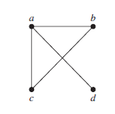
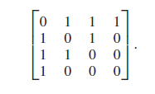
Example
Use an adjacency matrix to represent the graph shown in Figure:
a b c d
a
b
c
d

Slide 20
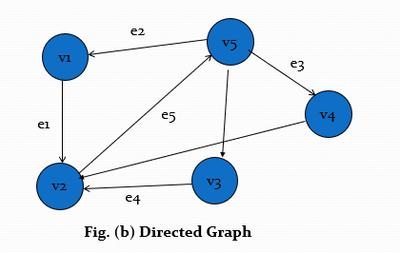
Adjacency Matrix Representation
1 2 3 4 5
1 0 1 0 0 0
2 0 0 0 0 1
3 0 1 0 0 0
4 0 1 0 0 0
5 1 0 1 1 0
Adjacency Matrix Representation of directed graph in fig (b)

Slide 21
Adjacency Matrix Representation
Adjacency matrix representation of a graph requires 0(v²) memory location irrespective of their number of edges in the graph.

Slide 22
Adjacency List Representation
The Adjacency List Representation of a graph G=(V,E) consists of an array Adj of |V| lists, one for each vertex in V.
For each u € V , the adjacency list Adj[u] contains all the vertices v such that there is an edge (u,v) € E i.e. Adj[u] consists of all the vertices adjacent to u in G.
The vertices in each adjacency list are stored in an arbitrary order.

Slide 23
Adjacency List Representation
Although the adjacency list representation requires very less memory as compared to the adjacency matrix.
The simplicity of adjacency matrix make it preferable when graphs are reasonably small.

Slide 24
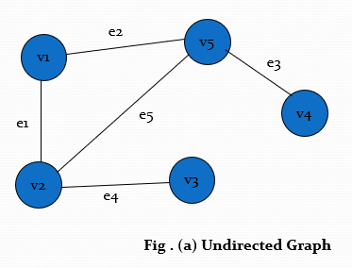
Adjacency List Representation
1
2
5
x
2
1
5
3
x
3
2
x
4
5
x
5
2
1
4
x
Adjacency list for undirected graph of fig.(a)

Slide 25
Adjacency List Representation
1
2
x
2
5
x
3
2
x
4
2
x
5
3
4
1
x
Adjacency list for directed graph of fig.(b)

